Slide 1

Week3
Integration of LEO Satellite Networks with 5G and 6G Terrestrial Networks.
YI-CHEN CHEN
Cybersecurity
Supervisor Muhammad Furqan
Cluster 6

Slide 2

Research Problem & Research Questions
Problem
Integrating LEO satellite networks with 5G and 6G terrestrial networks presents technical challenges.
Question
What are the key challenges in integrating LEO satellite networks with 5G and 6G terrestrial networks?
What are the performance impacts of integrating satellite and terrestrial networks on throughput, latency, and reliability?

Slide 3
1. Position, Navigation, and Timing (PNT) through Low Earth Orbit (LEO) satellites: a survey on current status, challenges, and opportunities. (2022). IEEE Journals & Magazine | IEEE Xplore. DOI: 10.1109/ACCESS.2022.3194050
Five-related papers
Latest information about Low Earth Orbit satellites
Complete by 19 researchers from different professional background and nationality
“all satellite-based navigation systems from MEO and GEO nowadays have orbits at least 19,100 km above sea level, which makes their signals reach Earth with a high attenuation due to inherent distance-based path losses during the satellite-to-ground wireless signal propagation.” --q1) challenges in integrating LEO satellite
“Later on, LEO-based broadband constellations, such as OneWeb, Starlink, and Kuiper emerged and aimed to offer high-capacity wireless connectivity globally, especially in remote areas that are hard to access via a terrestrial infrastructure.” --q2) the performance impacts of integrating satellite

Slide 4
2. Salahdine, F., Han, T., & Zhang, N. (2023). 5G, 6G, and Beyond: Recent advances and future challenges. Annals of Telecommunications, 78(9), 525-549. https://doi.org/10.1007/s12243-022-00938-3
Five-related papers
Full overview of latest 5G & 6G technology
“It is also the year predicted to introduce quantum computers powerful enough to break current cryptography algorithms. Cryptography remains the mainstay of securing the Internet and the 6G networks. Post quantum cryptography (PQC) algorithms are currently under development and standardization by the NIST (National Institute of Standards and Technology) and other regulatory agencies. PQC deployment will make the 6G goals of very low latency and low cost almost unachievable.” --q1) challenges in integrating LEO satellite & q2) the performance impacts of integrating satellite

Slide 5
3. Zhen, L., Bashir, A. K., Yu, K., Al-Otaibi, Y. D., Foh, C. H., & Xiao, P. (2020). Energy-efficient random access for LEO satellite-assisted 6G internet of remote things. IEEE Internet of Things Journal, 8(7), 5114- 5128. DOI: https://doi.org/10.1109/JIOT.2020.3030856
Five-related papers
“Due to unique characteristics of satellite environment, one of the main challenges in this system is to accommodate massive random access (RA) requests of IoT devices while minimizing their energy consumptions.” --q1) challenges in integrating LEO satellite
“To avoid additional signaling overhead and detection process, a long preamble sequence is constructed by concatenating the conjugated and circularly shifted replicas of a single root Zadoff-Chu (ZC) sequence in RA procedure.” -- q2) the performance impacts of integrating satellite

Slide 6
4. Luo, X., Chen, H. H., & Guo, Q. (2024). LEO/VLEO Satellite Communications in 6G and Beyond Networks–Technologies, Applications and Challenges. IEEE Network. DOI:10.1109/MNET.2024.3353806
Five-related papers
“ The terrestrial networks are severely constrained by high infrastructural costs, small coverage areas, and excessive deployment/maintenance investments, particularly in the remote regions such as the polar areas. Fortunately, satellites can be readily used to cover those places for providing high speed data services.’’ --q1) challenges in integrating LEO satellite
“Thanks to the advancements in waveform design and modulation technologies, the issue on the Doppler frequency shift and its impact on LEO satellite communications can be addressed effectively, together with a significantly extended data rate and coverage.” --q2) the performance impacts of integrating satellite

Slide 7
5. LEO Satellite Access Network (LEO-SAN) toward 6G: Challenges and approaches. (2024, April 1). IEEE Journals & Magazine | IEEE Xplore. DOI: 10.1109/MWC.011.2200310
Five-related papers
“In the aspect of the random access, the access architecture is also less flexible. Moreover, the highspeed moving satellite leads to the deterioration of the timeliness of the user’s access selection, which may severely affect the access of all kinds of service users”. --q1) challenges in integrating LEO satellite
“Additionally, the inter-satellite links are considered to play a pivotal role in LEO-SAN, since they can support flexible multi-hop data forwarding functions. More specifically, at certain regions (e.g., mountains or oceans) where ground base station can be hardly deployed, the feeder link is likely to be unavailable for the satellites within these regions.” --q2) the performance impacts of integrating satellite

Slide 8
1. Energy-Efficient Random Access for LEO Satellite-Assisted 6G Internet of Remote Things
Solutions/Tools
Guidelines for network architecture and random access algorithm design.
Advanced beam management solutions considering high mobility and limited payload budget.
Doppler-resilient signal processing schemes for classical modulation schemes and novel waveforms.
Main Findings and Conclusions
Efficient random access and beam management are critical for integrating LEO satellites with 6G networks.
Doppler effects significantly impact performance, requiring resilient signal processing techniques.
Advanced network architecture and algorithms can mitigate some integration challenges.
Strengths
Comprehensive analysis of random access and beam management issues.
Practical guidelines and solutions proposed for real-world applications.
Weaknesses
Limited empirical data to validate proposed solutions.
Focuses mainly on theoretical aspects without extensive simulations or experimental results.

Slide 9
2. LEO Satellite Access Network (LEO-SAN) Toward 6G: Challenges and Approaches
Solutions/Tools
Optimized design of random access algorithms for mobile broadband users.
Advanced beam management strategies for complicated propagation environments.
Doppler-resilient signal processing schemes for better transmission.
Main Findings and Conclusions
Addressing random access and beam management issues is crucial for effective integration.
Doppler effect mitigation is necessary for reliable communication.
Enhanced beam management and random access can improve overall network performance.
Strengths
Detailed exploration of random access and beam management issues.
Practical solutions proposed for real-world scenarios.
Weaknesses
Lacks detailed simulation or experimental data to support theoretical claims.
Focuses on specific aspects without a comprehensive view of the entire integration process.

Slide 10
3. LEO/VLEO Satellite Communications in 6G and Beyond Networks: Technologies, Applications, and Challenges
Solutions/Tools
Software-defined networks (SDN) and network function virtualization (NFV) for efficient resource management.
Cell-free massive MIMO systems for improved connectivity and performance.
Advanced remote sensing technologies for real-time earth observations.
Main Findings and Conclusions
LEO satellites can significantly enhance reliability and data rates in 6G networks.
Efficient resource management through SDN and NFV is critical for high-density satellite constellations.
Advanced technologies can support diverse applications and improve network performance.
Strengths
Comprehensive coverage of technical requirements and applications in LEO satellite communications.
Detailed discussion on the role of advanced technologies like SDN, NFV, and massive MIMO.
Weaknesses
General overview without specific focus on empirical validation.
Some proposed solutions may require further research to validate practical feasibility.

Slide 11
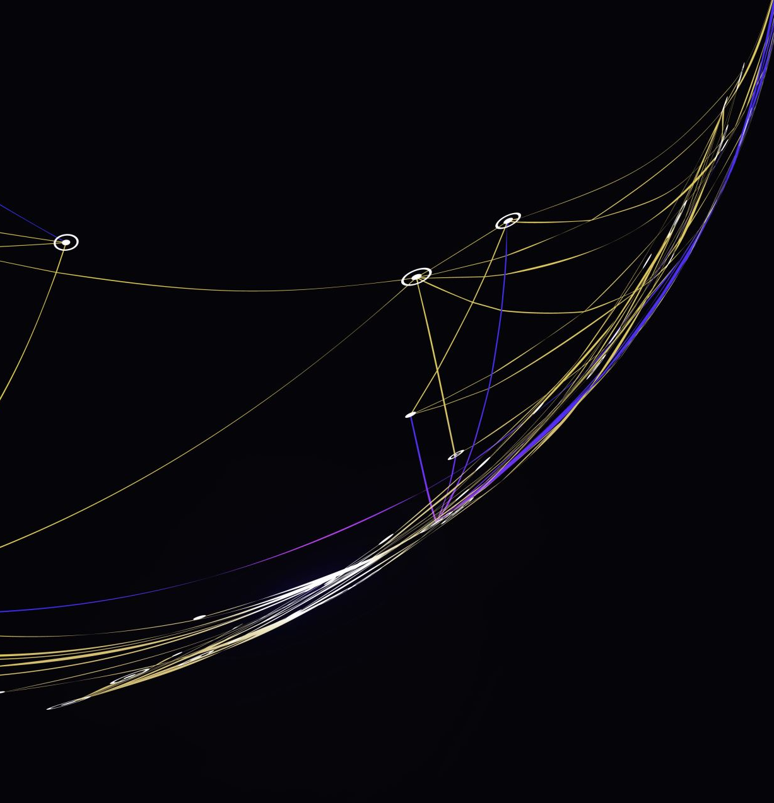
Gaps
Integration Challenges
Detailed understanding and solutions for the technical challenges of integrating LEO satellites with 5G and 6G networks, such as managing the physical resources, handling high-speed mobility, and ensuring reliable communication.
Performance Metrics
Quantitative analysis of the performance impacts (throughput, latency, reliability) of integrating satellite and terrestrial networks.
Lack of empirical data and simulations to validate theoretical models and proposed solutions.
Cost-Effective Deployment
Strategies for cost-effective deployment of integrated satellite-terrestrial networks, especially in low-income countries.
Consideration of affordability and regulatory barriers in the deployment of such networks.

